Slide 1
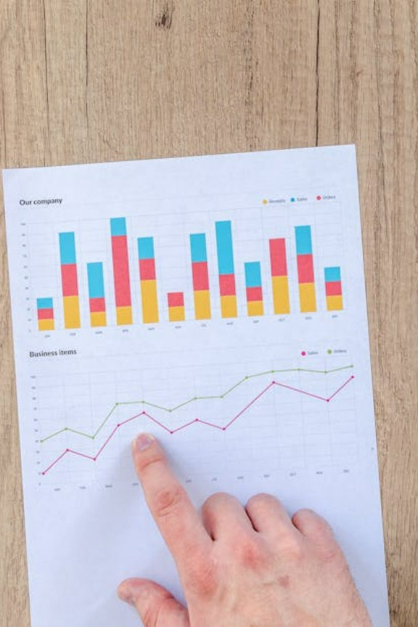
Basic Statistics for AI
Today’s Agenda
What is Statistics? Why is it important in AI?
Types of Statistics: Descriptive vs Inferential
Measures of Central Tendency: Mean, Median, Mode
Measures of Dispersion: Range, Variance, Standard Deviation
Visualizing Data using Pandas & Matplotlib
Hands-On Practice
Kahoot(Quiz)

Slide 2
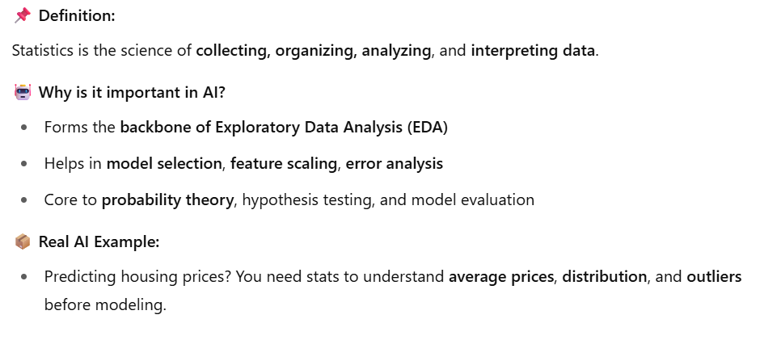
What is Statistics in AI?

Slide 3
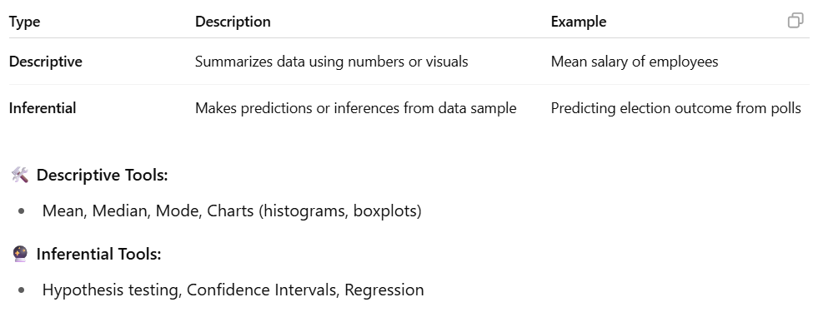
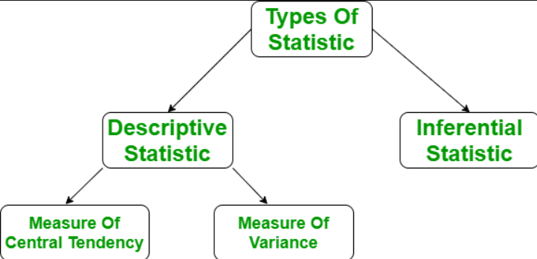
Descriptive vs Inferential Statistics

Slide 4
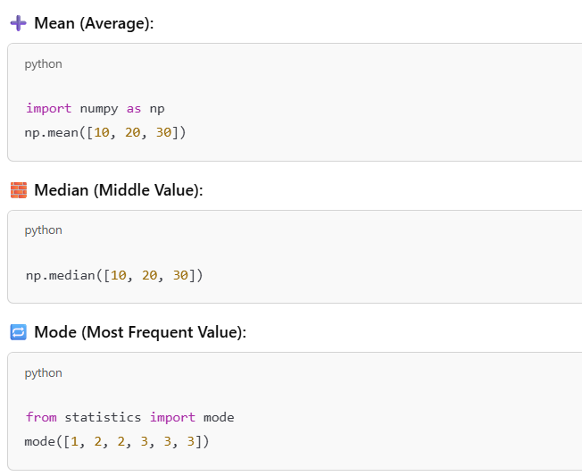
Measures of Central Tendency

Slide 5
Short break

Slide 6
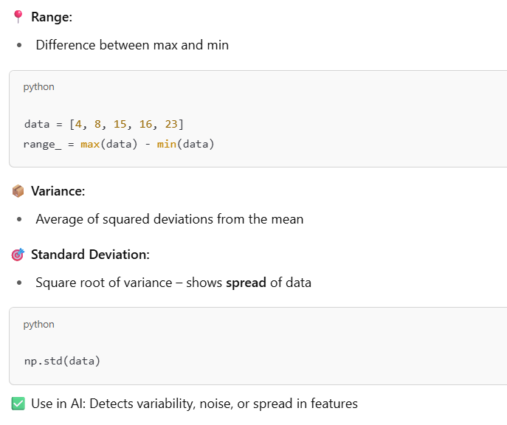
Measures of Dispersion

Slide 7
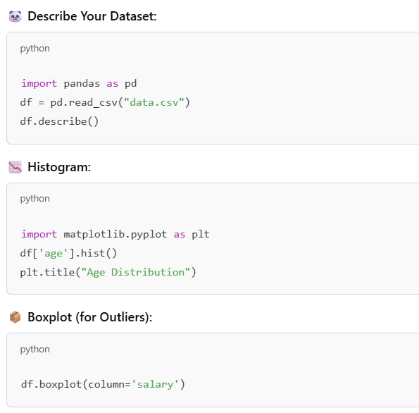
Visualizing Stats with Pandas + Matplotlib

Slide 8
Main Break

